Slide 1
Empirical Analysis of TSMC Microstructure Data
Muhammad Elfayoumi, Kevin Herbst, Zach Orrico, Abhishek Panchal

Slide 2
Overview
Data Analysis
Liquidity Analysis
Volatility Estimate
PIN Estimate
Analyzed TSM TAQ data from October 17, 2024
Evaluated trade activity during active trading hours
Focused on three key liquidity spreads:
Quoted
Effective
Realized
Calculated for active trading hours and across different hourly intervals during the trading session
Utilized the roll model to estimate essential trading parameters, like trading cost, efficient price volatility, daily and annual volatility
Estimated the Probability of Informed Trading by using the YZ and GAN models

Slide 3
Data Analysis

Slide 4
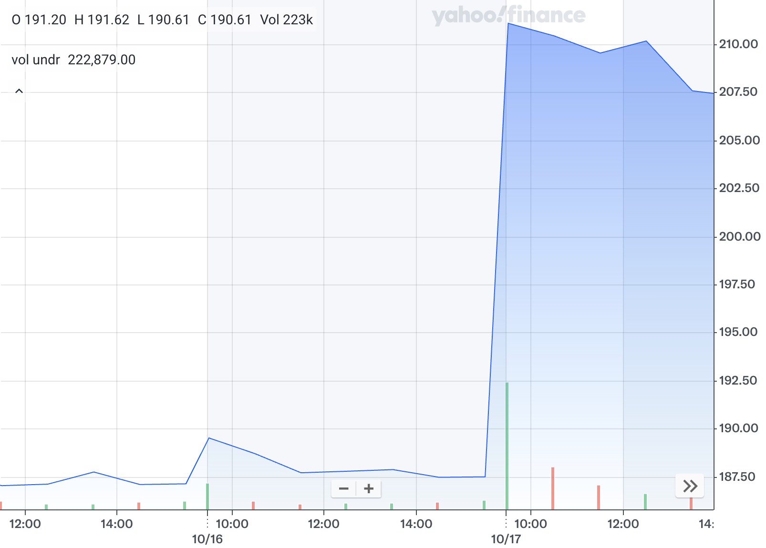
TAQ Data Overview
Received TSM TAQ data from Hanlon Lab’s Refinitiv database
Pulled data from October 17, 2024
TSMC reported their 2024 3Q earnings
Exceeded revenue expectations and their stock increased 12.57%, rising from the previous day’s close to the high on October 17th
This dataset included a total of 326,120 trades with 292,527 trades occurring during active trading hours (9:30 AM to 4:00 PM)

Slide 5
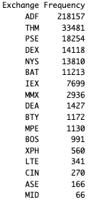
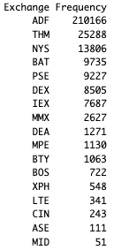
Trades Breakdown by Exchange
Figure 1
Figure 2
Figure 1 shows the trade breakdown by exchange for the entire day
Figure 2 shows the trade breakdown by exchange only during active trading hours
The ADF exchange experienced the most trades throughout the day
The top five exchanges are similar for the whole day and only during active trading hours

Slide 6
Liquidity Analysis

Slide 7
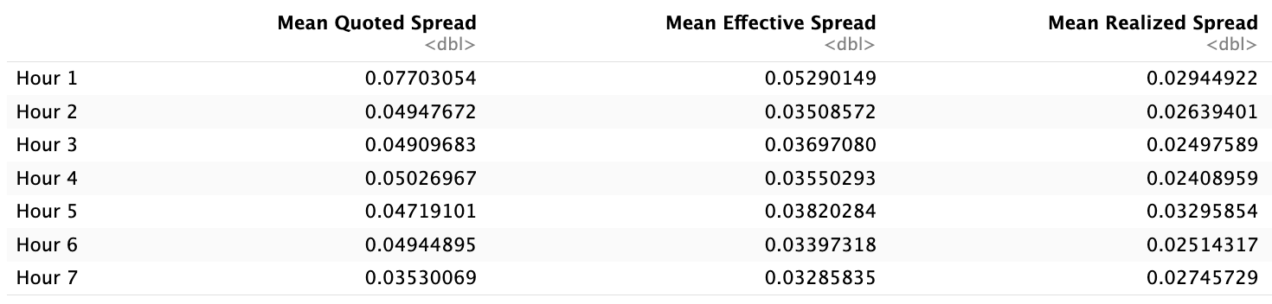
Average Spread Calculations
All average spreads begin high when trading opens but start to narrow as trading goes on.
The narrowing of spreads over the session indicates increased liquidity and reduced uncertainty later in the day.

Slide 8
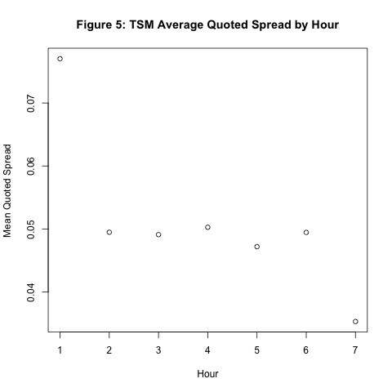
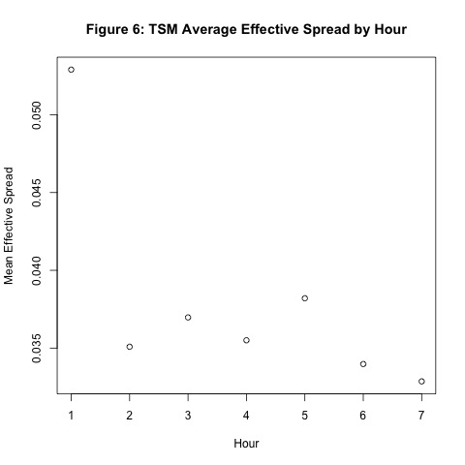
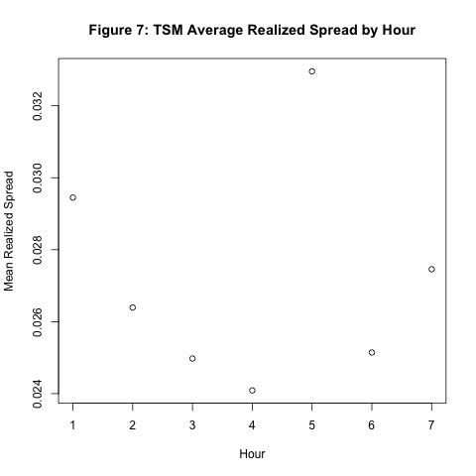
Spread Breakdown by Hour
The results demonstrate that TSM experiences improving liquidity as the trading session progresses, likely due to higher trading volumes and reduced uncertainty

Slide 9
Volatility Estimate

Slide 10
Roll Model Implementation
Uses covariance structures of price changes to derive parameters like trading costs, efficient price volatility, daily volatility, and annual volatility
Trading cost provides a proxy for the bid-ask spread, reflecting the cost incurred due to market frictions
Efficient price volatility captures the randomness of the underlying asset’s true value
Volatility helps quantify the risk of the stock
These numbers highlight how trading dynamics vary intraday, although this is just the active trading hours averages

Slide 11
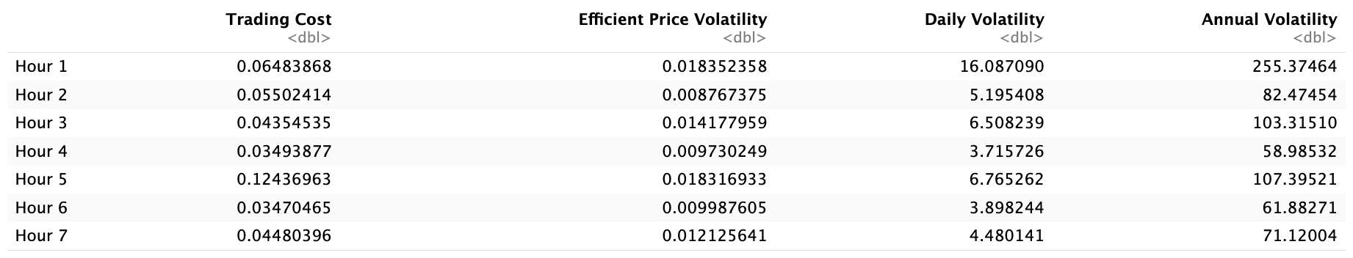
Roll Model Results
Highest Trading Cost: Hour 5 (0.1244) → Indicates reduced liquidity
Lowest Trading Cost: Hour 4 (0.0349) → Suggests higher liquidity
Highest Efficient Volatility: Hour 1 (0.0184) → New information from overnight developments is incorporated into shift prices
Lowest Efficient Volatility: Hour 2 (0.0088) → Signifies a calm period
Highest Annual Volatility: Hour 1 (255.37) → Market open period where overnight trades are being processed
Lowest Annual Volatility: Hour 4 (58.99) → Reflecting a quieter period

Slide 12
PIN Estimate

Slide 13

PIN Model
Uses 5 parameters defined below combined with the use of MLE to estimate the Probability of Informed Trading
Parameters
𝛼 = intensity of news arrival
δ = probability of bad news
μ = probability of an informed buy or sell
ε_{b}, = probability of an uninformed buy
ε_{s}, = probability of an uninformed sell
The value of PIN is then calculated using the formula:

Slide 14
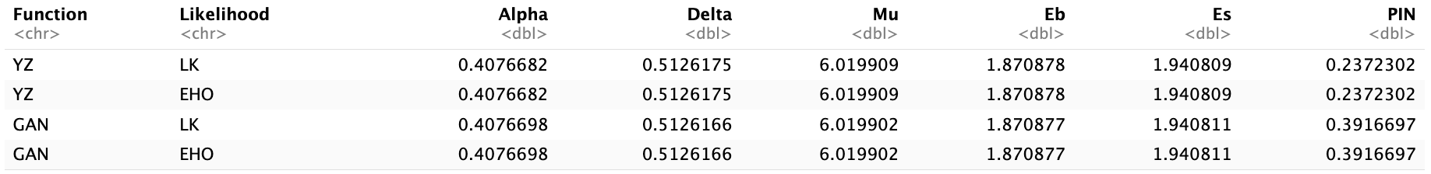
Results and Interpretation
Four models were tested: two using the YZ approach and two with the GAN approach, each with EHO and LK factorizations, yielding almost identical results between EHO and LK
Both algorithms agreed on five parameter values but differed in calculating the Probability of Informed Trading (PIN)
The PIN ranged between 23% and 40%, significantly higher than the typical 10%, likely due to earnings-day activity and insider-informed trading.

Slide 15
Conclusion

Slide 16
Summary
This project investigated the microstructure of TSM with TAQ data
After computing various liquidity measures, implementing the Roll model, and finding the PIN measure, the results showed a clear pattern
As the spread narrowed and volatility decreased throughout the day, markets became more efficient and liquidity improved
From the above-average PIN value, it’s evident that TSM’s earning announcement on October 24, 2024, impacted trading as more informed trading was observed
This analysis serves to prove how important it is to integrate advanced models that study market efficiency and trading behaviors

